Slide 1
Decentralized Investment Banking
The Case of Discount Dividend-Reinvestment and Stock-Purchase Plans

Slide 2
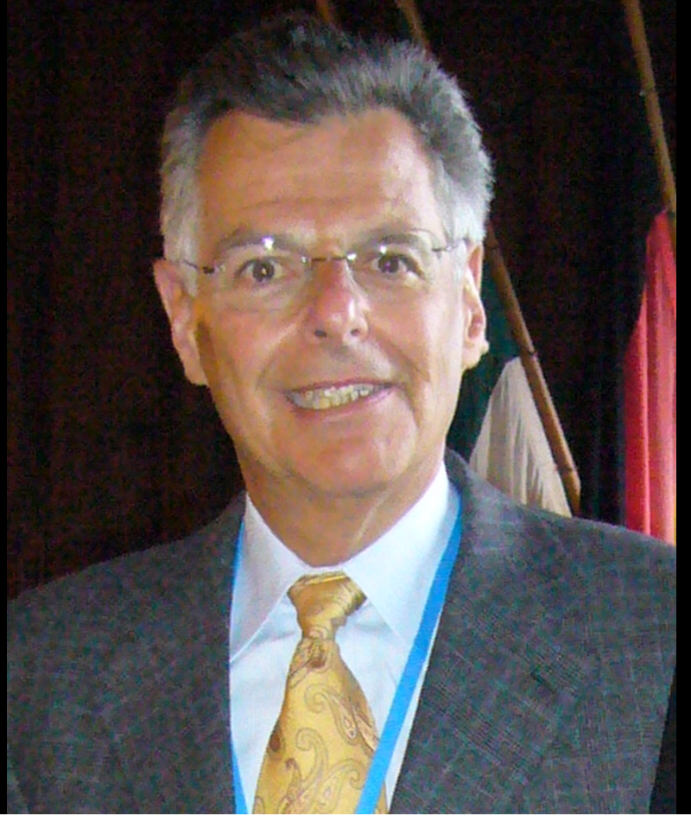
Myron S. Scholes
Professor of Finance, at the Stanford Graduate School of Business
Co-originator of the Black-Scholes options pricing model
Dimensional Fund Advisors Board of Director
He was a principal and Limited Partner at Long-Term Capital Management, L.P. and a Managing Director at Salomon Brothers.
Scholes earned his PhD at the University of Chicago.

Slide 3
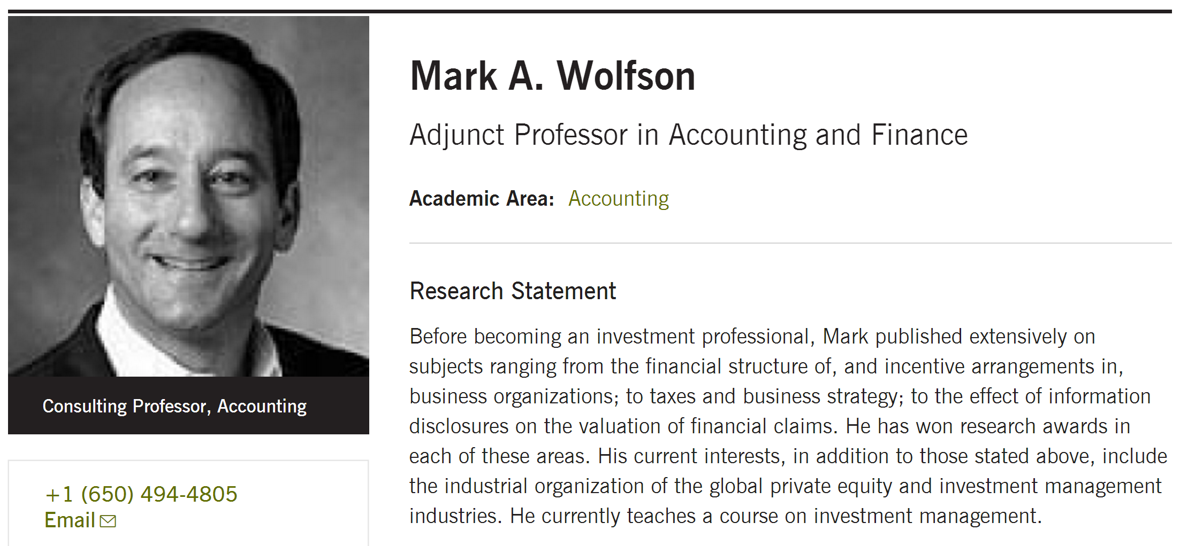
Stanford|harvard|U Chicago|mit

Slide 4
idea
Discount Stock
Purchase Plans
Raise Capital
New Stock Offerings
Underwriting Fees

Slide 5
Outline
Tested the degree to which individual investors can profitably serve this investment banking function
Why it takes firms so long to raise the target level of capital
Why many eligible shareholders do not participate in these discount plans

Slide 6
Investment Strategies
The right to buy additional shares at a discount, typically 5.263% (or 5/95) from extant market prices
>=1 share of company stock in certificate form and sign up to participate in the discount stock-purchase program
Mail in a check for stock periodically
The company then issued, free of commissions, discounted shares that could be sold in the market within a few weeks
$200,000
$163,800 net discount income
$182,600 return on investment
$74,600 abnormal return on investment
$421,000

Slide 7
Features
Industry Concentration
Investment Ceilings and Discounts
Actual Discount Calculation
Costs of Participating in the Plan

Slide 8
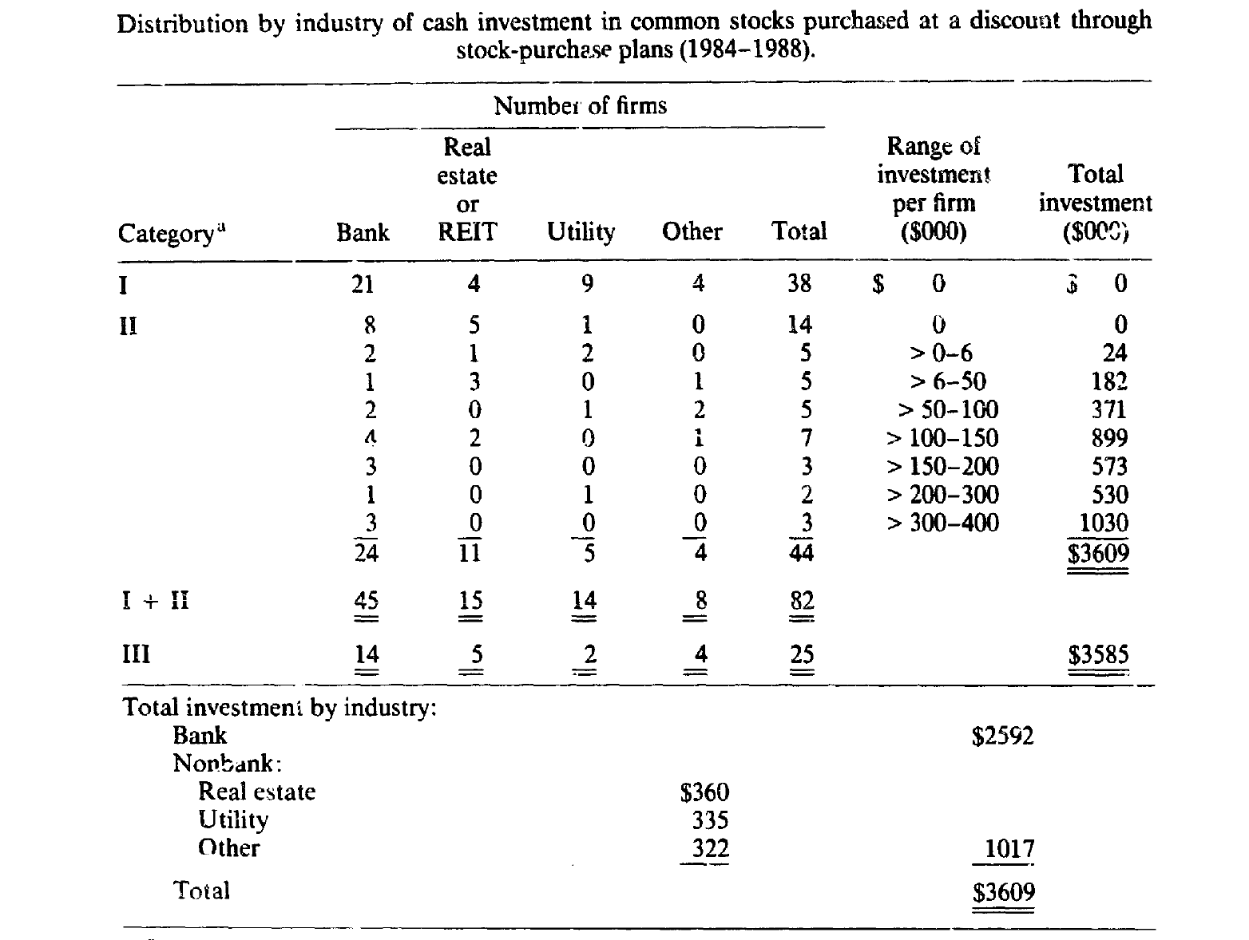
Industry Concentration
74 out of 82
2.6M out of 3.6M

Slide 9
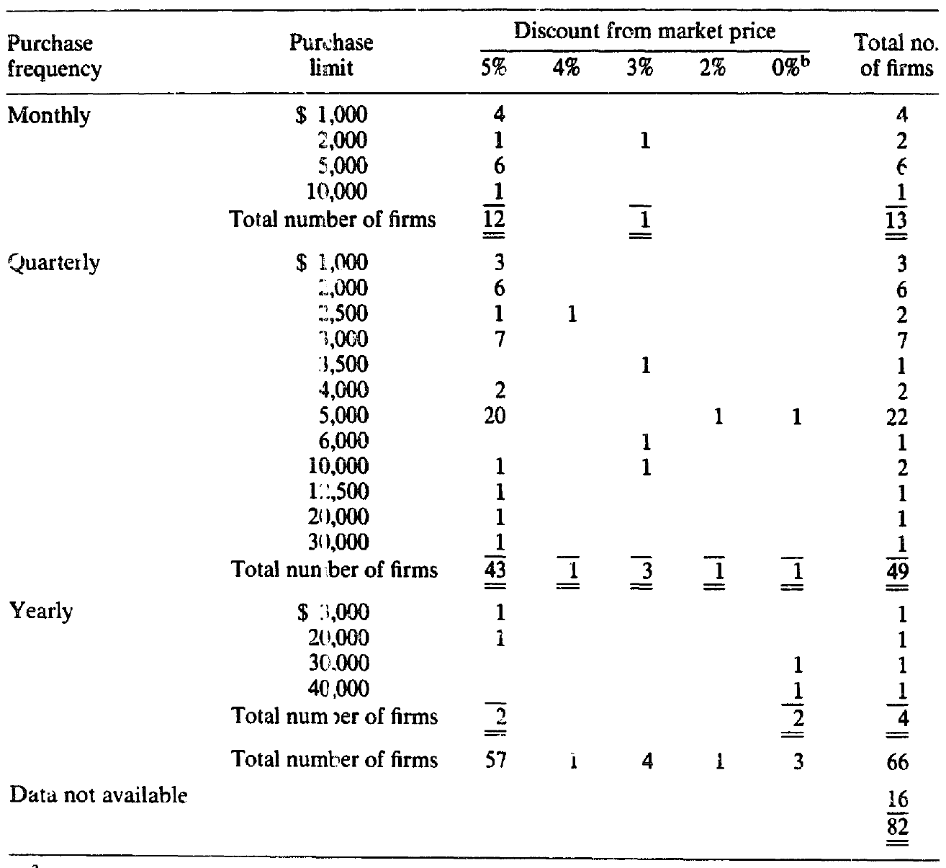
Investment Ceilings and Discounts
57 out of 66 (5%)
13 monthly
49 quarterly
4 annually

Slide 10
Actual Discount Calculation
Which prices to use: last traded (40%), daily high and low (about 40%), closing bid and ask (1 in 6)
The averaging period varies. (60% ends on the day of investment, the rest on the day before)
The date by which investment funds must reach the plan administrator varies.

Slide 11
Costs of Participating in the Plan
Informed
Undesired Market Risks
Monitor
Secondary Market Transaction Costs
Margin Requirements & Tax Laws

Slide 12
3 Hedges against stock-price declines
Purchase in-the-money put options
Sell short
Macro hedge – purchase actively traded put options on a market index

Slide 13
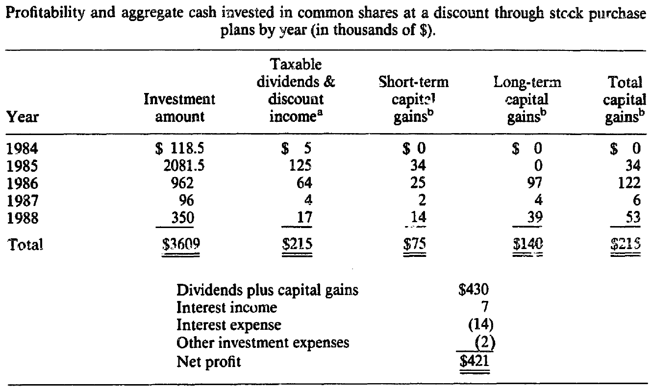
Stock Performance

Slide 14
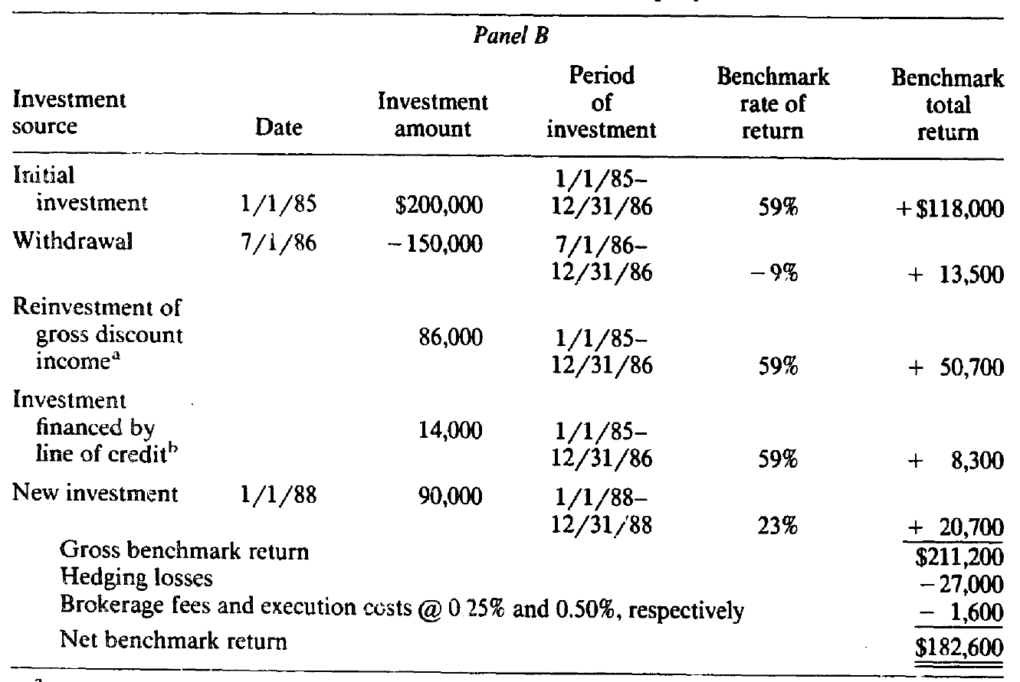
Naïve investment Strategies

Slide 15
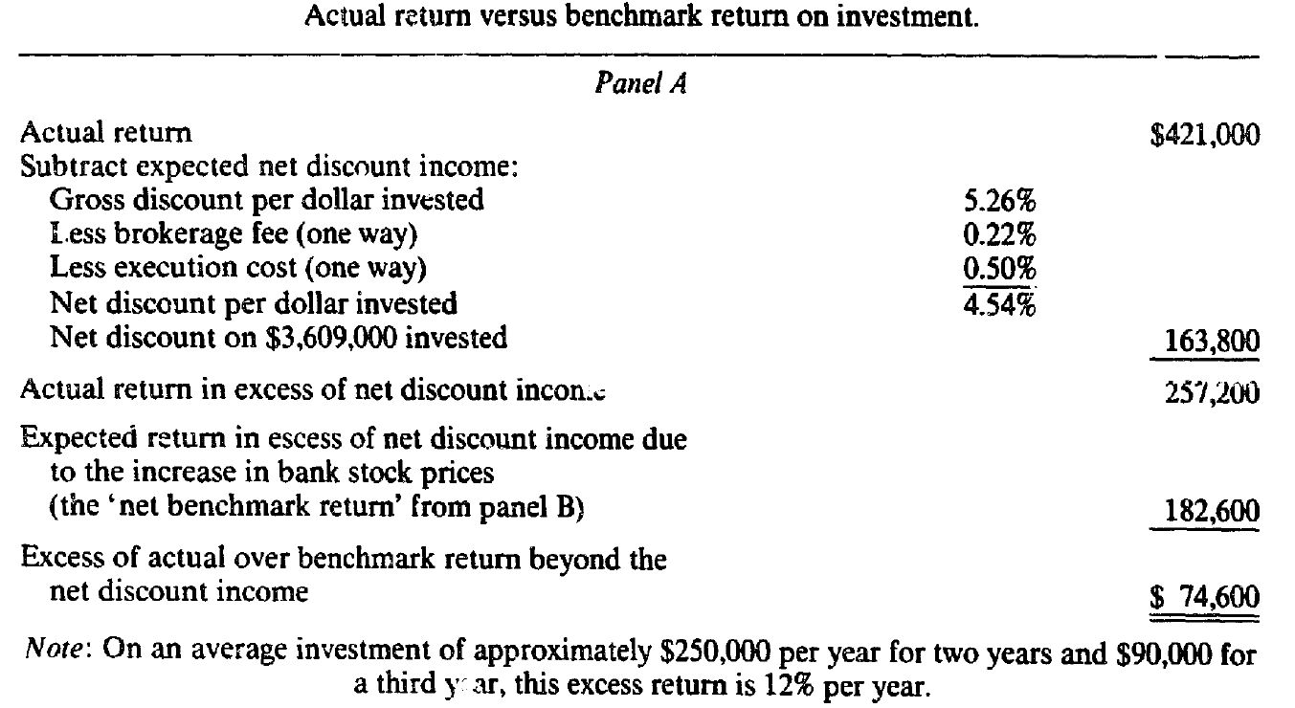
Actual Return vs. Benchmark ROI

Slide 16
Discount stock-purchase plans
Conventional underwritings

Slide 17
Decentralized investment banking
Underwriting
Fees
Discounts
Better off?
Most shareholders do not participate in discount programs.

Slide 18
Why?
Firms are willing to incur high costs to pay dividends and then issue an offsetting amount of new equity.
Tax cost of paying dividends
Administrative cost of running the discount program
Transaction costs associated with resales of shares in the secondary market
!!! The cost to existing shareholders of offering 5% discounts to new shareholders

Slide 19
Conclusion – termination of cash discounts
A 5% discount is too generous to maximize the welfare of current shareholders
Elimination of discounts on optional cash purchases (e.g. BOA)
Firms raised the target level of capital (e.g. slow down the rate at which capital is raised) --- adverse selection related cost --- depress share prices
Divided: some found it cost effective, others less favorable

Slide 20
WAIT TO SEE
Capital hungry companies and banks gear up for the next round of capital raising
Discount?

